Slide 1
Research Methodology- Unit 5 DATA COLLECTION AND ANALYSIS
Prime College- BIM 6th Semester

Slide 2
Research Methodology- Unit 5 Chapter 4- Observation-Concepts and Methods
Prime College- BIM 6th Semester

Slide 3


Learning Outcome 1
Observation
Concepts,
Characteristics,
Methods

Slide 4
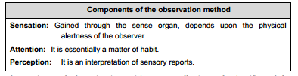
Observation-Concept and Methods
The observation method in data collection is a peculiar aspect of qualitative data generation in which the researcher collects the data directly with the observation.
The main feature of observation is to keep an attentive, curious, and natural watch over an intended object, event, or phenomenon.
Hence, observation is simply a purposeful and systematic way of watching or listening over phenomena to generate non–verbal or visual data.

Slide 5
Characteristics of Observation Method
Utmost use of human sense organs like hearing, watching, listening, touching, smelling, etc., but consists of physical and mental activity.
The visual sense of the observer predominates the observation method.
Selective and Purposive
Helpful to generate non–verbal data for abstract phenomena and non verbal behavior like aggression, frustration, etc.
Possible to study spatial behavior. Spatial behavior refers to the attempts of individuals to structure the space around them. For example, observing the spatial movement of an individual, like moving forward, moving away from, maintaining closeness, and maintaining distance.
Helps study extra–linguistic or non–content behavior like rate of speaking, loudness, the tendency to interrupt, and pronunciation peculiarities constitute fruitful data source.
Facilitates studying group behavior in a single glance. Establishing cause–and effect relationships in social phenomena is possible.

Slide 6
Observation Method
Advantages
Disadvantages
 Anextensive method regarding time and resources, but data obtained
through it are limited. It is prone to interference in the observational task by
some unforeseen factors.
 This method is not freed from the risk of personal biases and prejudices of the
observer.
 Social phenomena like emotions, affections, aggressions, thoughts, etc., are not observable perfectly.
 Impossible to study or observe past behavioral patterns and activities.
 If the study units know that the researcher observes them, they may change their activities, attitudes, and behavior
Kothari (2009) mentioned the following advantages of the observation method:
 Can record the natural behavior of groups.
 Can even gather information that could not easily be obtained.
 Can verify the truth of statements made by informants in the context of a questionnaire or a schedule.
 A valuable method for generating non-verbal and extra-linguistic data.
 More objective and impersonal data can be drawn through observation.

Slide 7
Methods of Observation in Data Collection
Participative observation
Participative observation is one of the least controlled methods of observation in which observers include themselves as a member of observed events or other people to be observed.
Actual participants of the study are generally unaware that their activities are being observed for some research purpose.
Also known as observeras-participant method.
Provides the opportunity to discover observable data naturally, i.e., this method helps in generating realistic and quality data. Observers can record habits, behavioral patterns, language, working patterns, and so forth, like activities minutely.

Slide 8
Participative Observation
Advantages of participative observation
 High Validity- The researcher collects the data by themself without informing the study units.
 Researcher gets deeper insight into meanings, viewpoints, values, and problems, giving more authentic data.
 More flexible and allows for an open mind. The researcher can follow up with different directions/ideas.
 The researcher gets the advantage of participating to access more suspicious groups. This method becomes more valuable when questioning becomes ineffective
Disadvantages of participative observation
 Ethical issues of secret participation in collecting information. Deceiving people to gain information about them is wrong. Similarly, participating in illegal and immoral research activity is equally wrong.
 This method is time-consuming, demanding trained researchers to recognize specific details, and can be more demanding and stressful.
 A small sample size cannot be representative.
 Participation may increase the risk of bias if other people get some hint of the involvement of the researcher in the group.

Slide 9
Non-participative observation
The non-participative observation method is a strategy for collecting qualitative data in which the researcher does not participate or interact directly with the social phenomenon.
In this method, the researcher directly observes the intended activities of members without being a member of a group of respondents or a study unit.
Also called direct observation.
In non-participant observation, group members may or may not know about the researcher’s observation about them

Slide 10
Non-participative observation
Advantages of non-participative observation
 Have limited or no access to a particular group to participate in their activities.
 The researcher’s direct involvement in some settings might be dangerous.
 It is possible to cautiously eliminate the risk of people’s changing behavior in the presence of researchers.
 Is applicable in such a condition where the participation of researchers in the group is inaccessible or impossible.
 Is reliable for studying a group whose members are not reactive to the observer so that no change may occur in their original behavior.
 More ethical if done overtly – no ethical issues if people are aware they are being observed.
Disadvantages of non-non-participative observation
 There is a chance of acting differently as people know they are being observed (Hawthorne effect).
 It becomes hard to gain accurate results watching from a distance.
 There is a chance of impression of researcher in research.
 This method is time-consuming and costly.

Slide 11
Use of the Internet for Data Collection
Internet Data Collection (IDC) is a means of quick survey data collection by utilizing the internet.
The questionnaire is prepared using browser-based internet forms and sent to the prospective respondents via the internet in their mail ID.
Respondents fill in the form and return it to the researcher’s browser.
A system administrator retrieves the completed forms and routes them for further processing.
If there are other modes of data capture, the system administrator will consolidate the returns submitted via the Internet with those obtained by the other modes

Slide 12
Advantages of using Internet Data Collection
For the respondents
 IDC survey provides a quick and convenient channel for the survey respondents to submit their forms via the net.
 Respondents can be free from the hassle of filling out paper questionnaires and mailing them back to the research agency.
 This method helps to save time and effort for respondents.
 Respondents need not answer all the questions at once; respondents can save the data on the web server and complete it when they are at ease.
 The forms will be designed in a simple and attractive format to attract the respondents to provide data.
 If the data the respondent finally provides is clear and complete, no manual intervention is required by the research agency.
 As the respondents do not need to fill out forms in front of the researcher, they can conveniently provide the information even in sensitive subject matter.
For the research agency or researcher
 It reduces the time for data collection as surveyors need not visit the respondents personally.
 The submitted data are transferred from the web server to an internal database maintained by the agency. Hence, it reduces the effort for data entry and data editing.
 The online survey form has built-in validation checks, so it reduces the effort needed to check for incomplete forms and then call respondents to obtain the required data.
 The IDC survey helps to expedite survey operations and the compilation of data.
 The research agency can disseminate the statistical information to other organizations and the public within a shorter period.

Slide 13
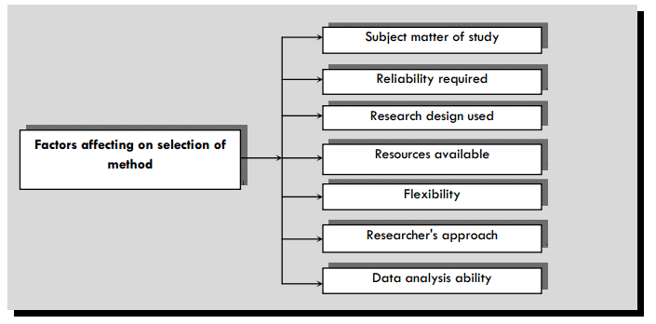
Factors Affecting the Selection of Data Collection Method

Slide 14
Factors Affecting the Selection of Data Collection Method
Subject matter of study:
Researcher should select the data collection method as per the subject matter of study, its complexity, scope and nature of the subject. Social research and laboratory research demand different types of data.
In some socially challenging area of study like drug abuse, prostitutions, HIV AIDS, etc., data collection becomes more difficult in comparison to the satisfaction level of an employee in organization.
Some research studies require past secondary data, while some studies, like social changes, habits, behavioral changes, etc., demand the most current data.
Thus, the data collection method must fit the subject matter of the study
2. Reliability required:
Data reliability is equally important for each research, depending on the respondents and the data collection method.
For example, if the data is collected using the interview method, its reliability ranges higher than the questionnaire.
However, through interviews, we cannot collect data from many respondents.
For extensive coverage, the questionnaire method becomes more appropriate

Slide 15
Factors Affecting the Selection of Data Collection Method
3. Research design used:
The researcher selects different research designs based on the scope of the study.
Different research designs demand different types of data.
For instance, observational data is more practical if the research design is descriptive.
In contrast, if the research design is policy research, in–depth interviews or focus group discussions can be appropriate for data collection.
4. Resources available:
The availability of financial, time, and human resources is another critical factor affecting the choice of data collection method.
Internet data collection and questionnaire methods are more appropriate in case of a shortage of resources mentioned above.
If such resources are adequate, observation and interview methods can be applied, taking other things ignored.

Slide 16
Factors Affecting the Selection of Data Collection Method
5. Flexibility:
The researcher should take flexibility as one of the important considerations while selecting the data collection method.
Flexibility in information requirements plays an essential role in selecting a method.
Researchers approach:
The Researcher’s approach to source of data is the most crucial consideration while selecting the data collection method.
For instance, if the researcher has limited or no approach to the policymaker, the interview method of data collection becomes impossible.
Similarly, the experiment method may not be suitable for the early researchers, though this method provides accurate data.
7. Researcher’s ability to analyze the data:
Data collection is not the final stage in research.
Data must be analyzed to get a conclusion. Some data analysis requires special statistical techniques and analytical power.
Without it, the researcher may not conclude the findings appropriately.
Thus, the researcher should consider their data analyzing capability.

Slide 17
End of Chapter 4
(Click the arrow when in Slide Show mode)
Notes:
In Slide Show mode, click the arrow to enter the PowerPoint Getting Started Center.

